Slide 1


New Year’ Eve/ New Year’s Day
HOLIDAYS AND FESTIVALS

Slide 2

A New Year’s resolution is a goal you make for the coming year. It is usually a promise you make to yourself. It is an interesting way to change your life for the better.
Here are some of the most often New Year’s resolutions people make at the beginning of the year.
eat healthier
save money
improve at job/school
take up a sport/hobby
learn how to play a musical instrument
spend more time with friends
help people in need
What are your New Year’s resolutions? Think and tell the class.

Slide 3
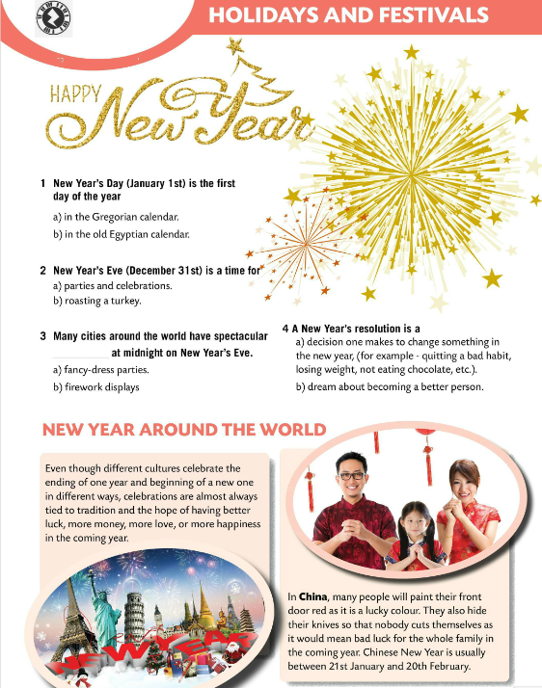
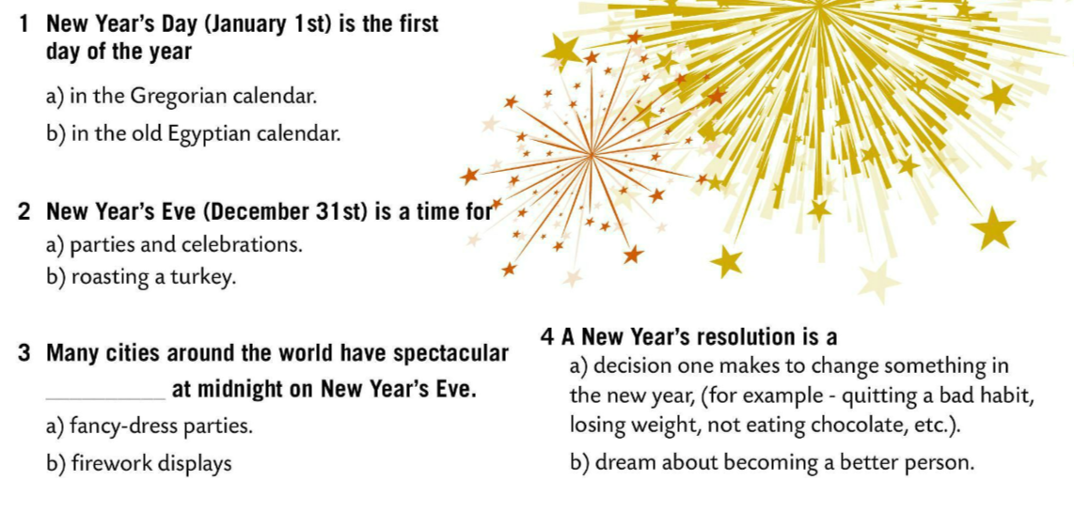
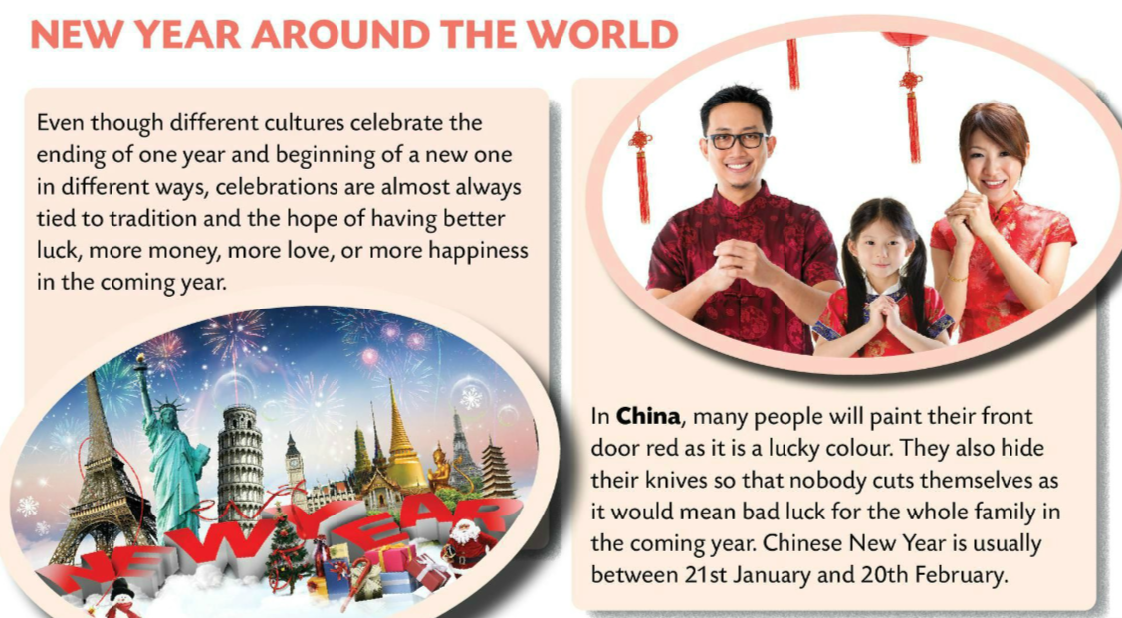
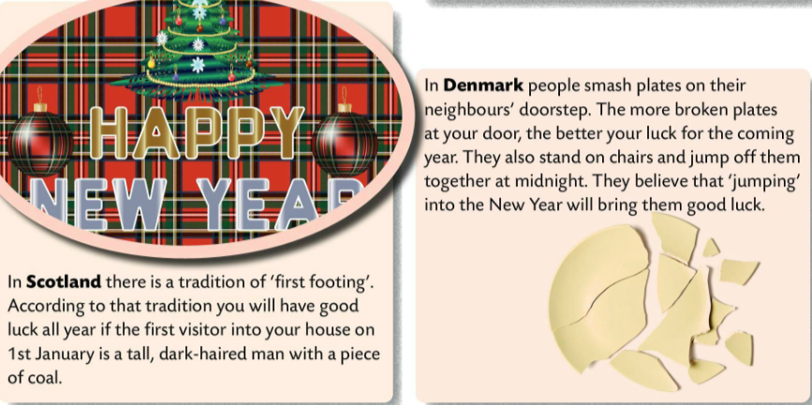
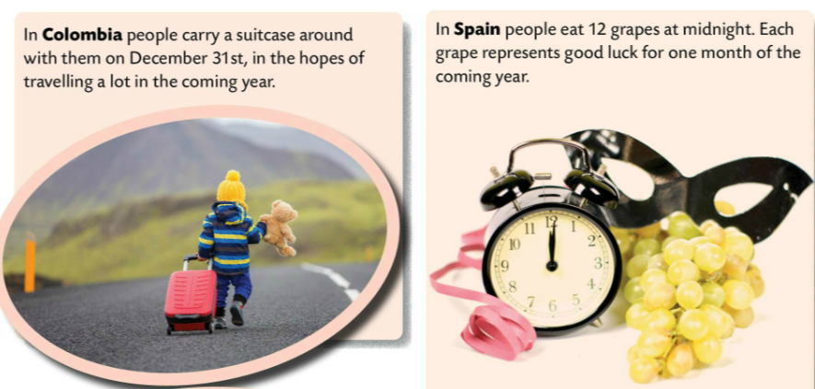
Do the quiz. Choose a) or b).
Check.
Read the text about New Year celebrations around the world.
Find the following words/phrases in the text and then translate them.
coming year
in the hopes of
represent
coal
smash
doorstep
nadolazeća godina
u nadi da će/nadajući se kako će
predstavljati
ugljen
razbiti
kućni prag

Slide 4
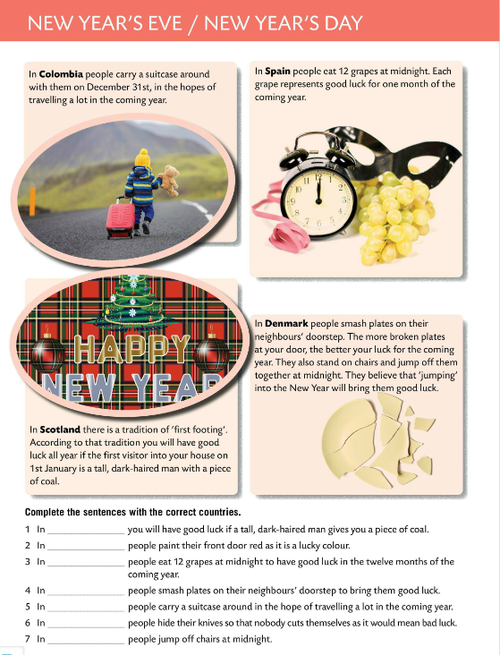
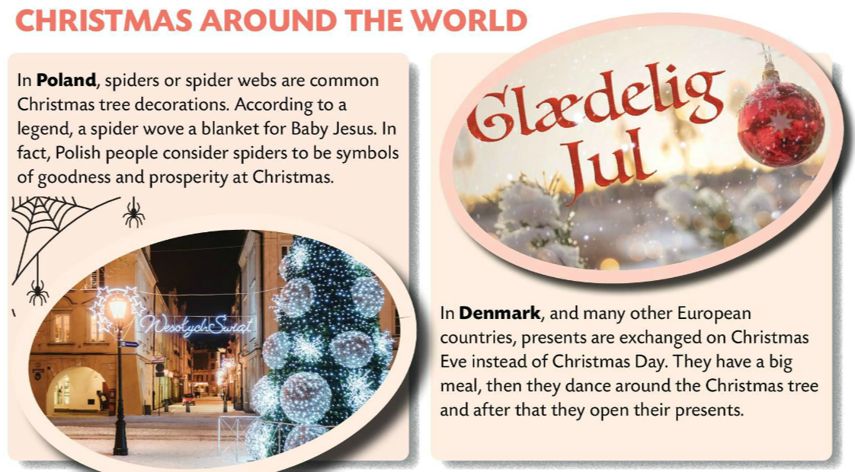
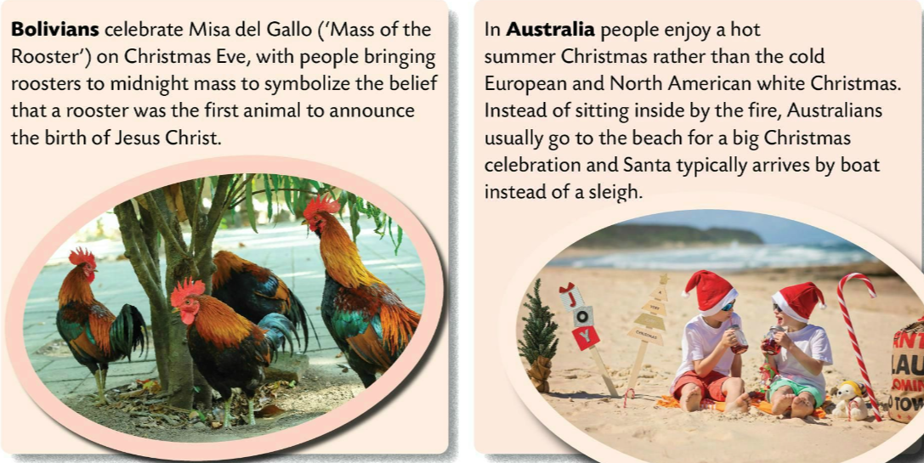
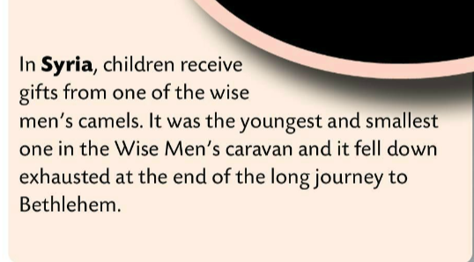
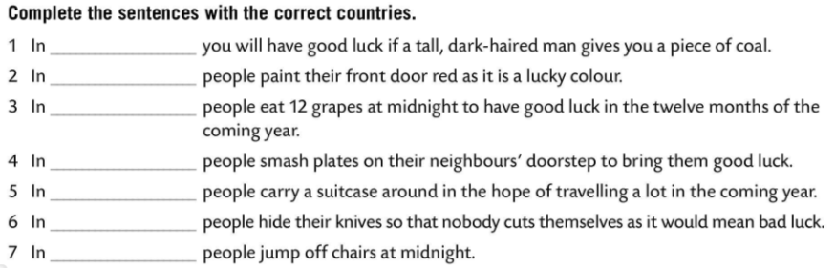
Read the text again.
Close your books. Choose one country and talk about New Year traditions in that country.
Scotland
Which way of celebrating do you like the most?
Why? Think and tell the class.
China
Spain
Denmark
Colombia
China
Denmark
Complete the sentences with the correct countries.
Check.

Slide 5
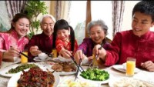
Learn more about Lunar New Year. Learn about these special holiday’s traditions, from getting a haircut to street celebrations.

Slide 6


How do you celebrate New Year in your country? Create a poster. Present your poster to the class.

